Slide 1
AC FET ANALYSIS
Oleh:
Suwito
mas.suwito@gmail.com
masaji@elect-eng.its.ac.id
Departemen Teknik Elektro
Institut Teknologi Sepuluh Nopember
2009

Slide 2
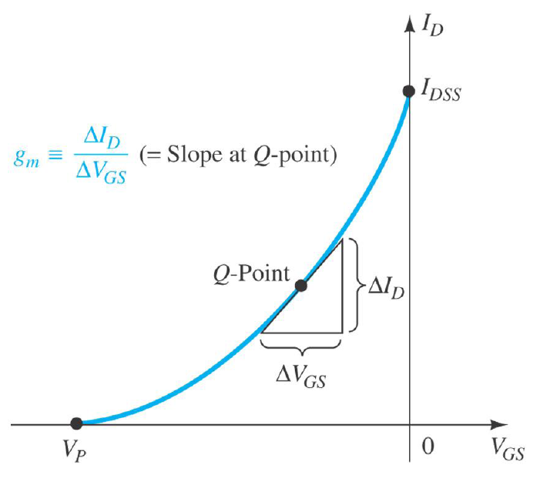



Definisi Gm
The gate-to-source voltage controls the drain-to-source (channel) current of an FET.

Slide 3
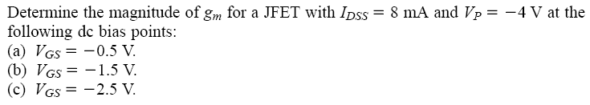
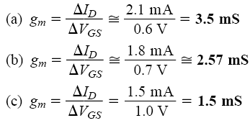
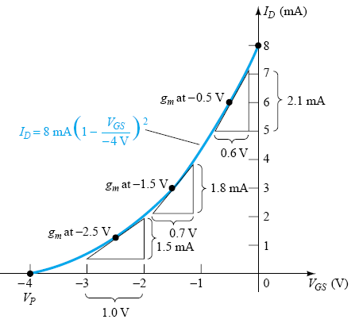
CONTOH

Slide 4
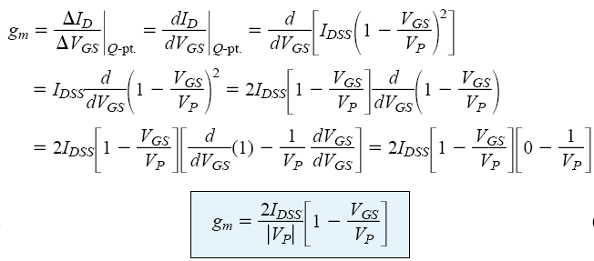
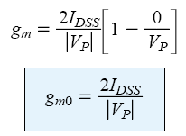

Gm
The derivative of a function at a point is equal to the slope of the tangent line drawn at that point.

Slide 5

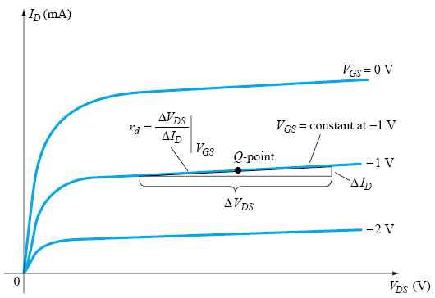


FET Input and Output Impedance
FET Input Impedance Z_{i}
FET Output Impedance Z_{o}
The parameter y_{os} is a component of an admittance equivalent circuit, with the subscript o signifying an output network parameter and s the terminal (source)

Slide 6
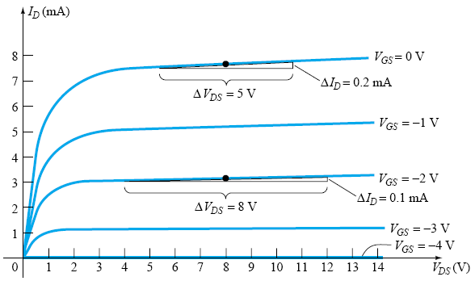


CONTOH
Determine the output impedance for the FET for VGS 0 V and VGS 2 V at VDS 8 V.

Slide 7
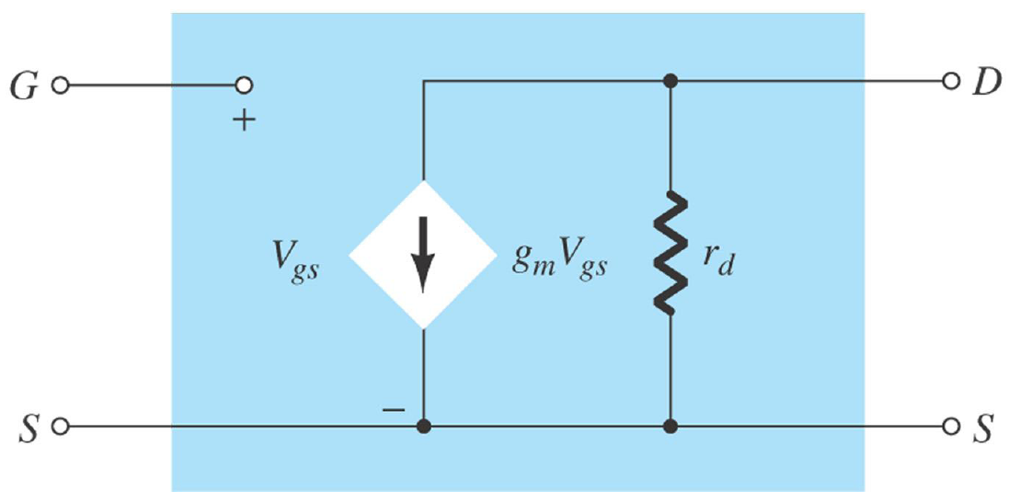
FET AC Equivalent Circuit

Slide 8

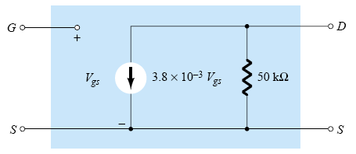
CONTOH

Slide 9
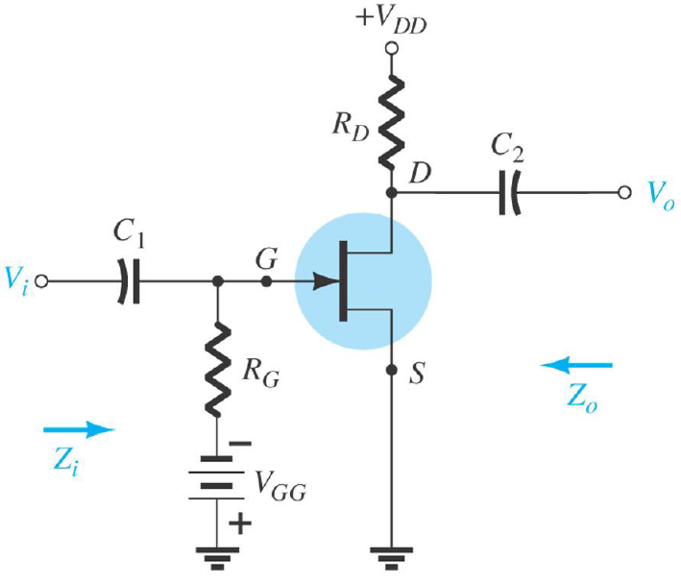
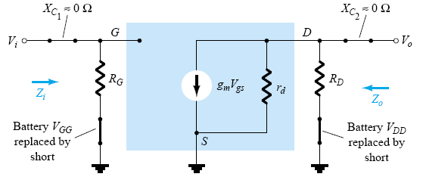
JFET FIXED-BIAS CONFIGURATION

Slide 10
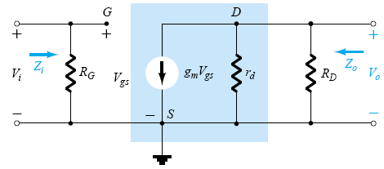

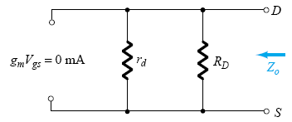
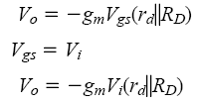




JFET FIXED-BIAS CONFIGURATION

Slide 11
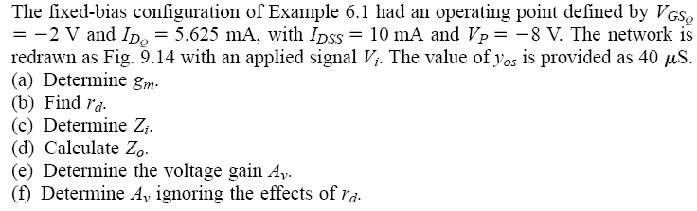
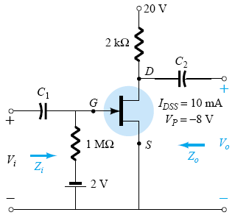
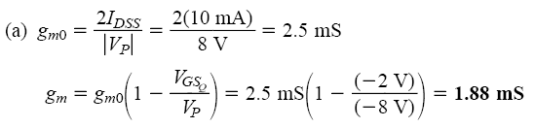

CONTOH

Slide 12
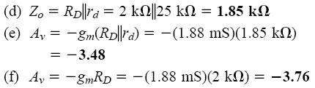
CONTOH

Slide 13
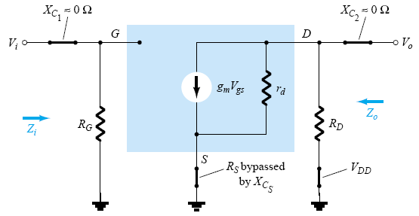
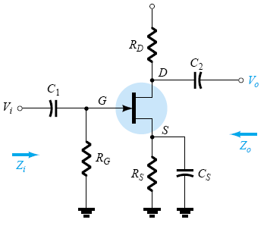
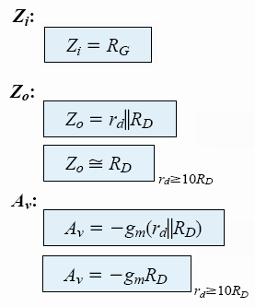
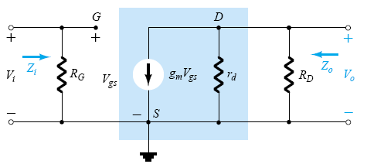
JFET SELF-BIAS CONFIGURATION
Bypassed R_{S}

Slide 14
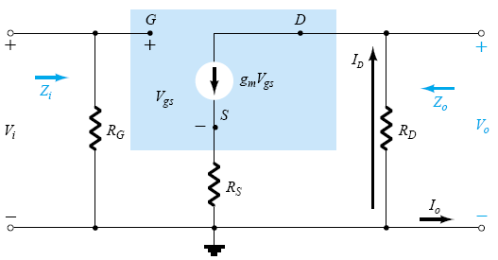


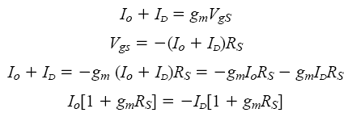




JFET SELF-BIAS CONFIGURATION
Unbypassed R_{S}

Slide 15
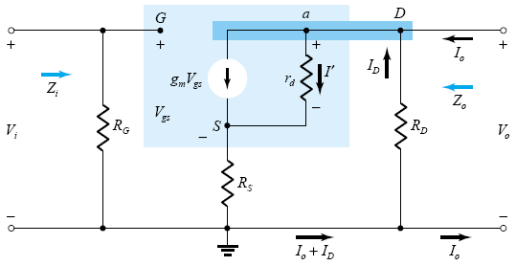
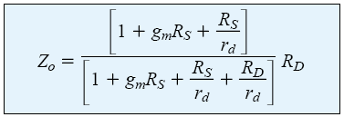

JFET SELF-BIAS CONFIGURATION
Unbypassed R_{S}

Slide 16



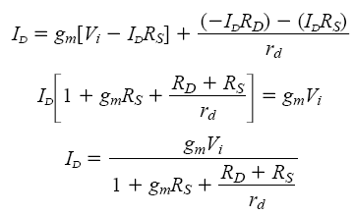
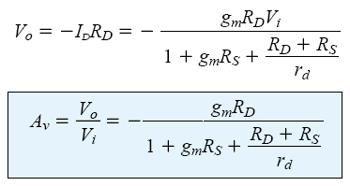
JFET SELF-BIAS CONFIGURATION
Unbypassed R_{S}

Slide 17

JFET SELF-BIAS CONFIGURATION
Unbypassed R_{S}

Slide 18
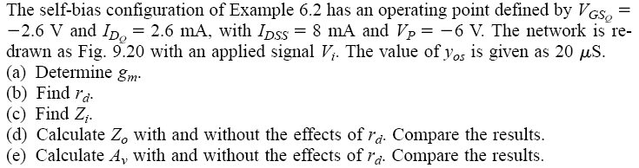
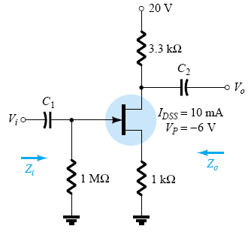
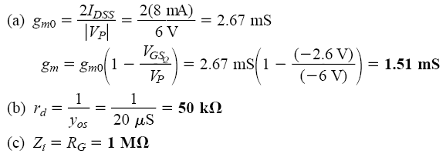
CONTOH

Slide 19
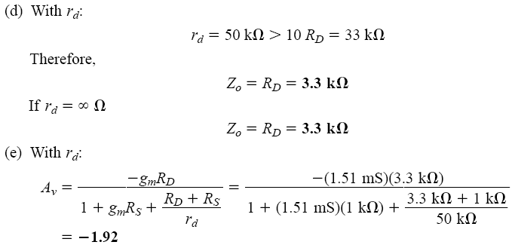

CONTOH

Slide 20
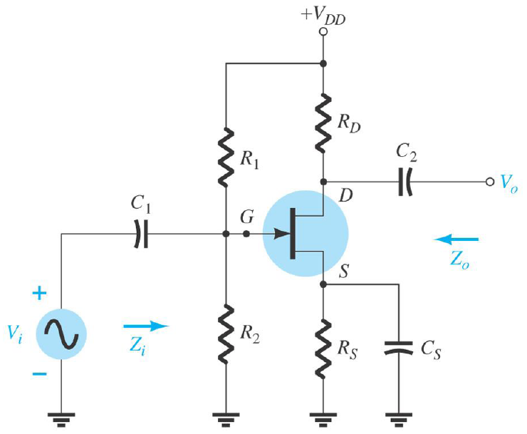
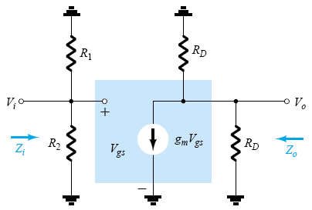
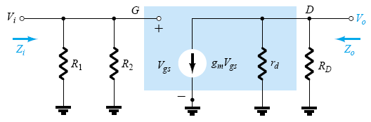
JFET VOLTAGE-DIVIDER CONFIGURATION

Slide 21


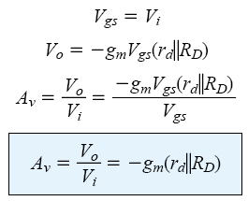


JFET VOLTAGE-DIVIDER CONFIGURATION

Slide 22
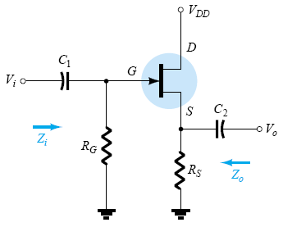
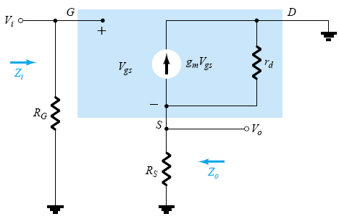
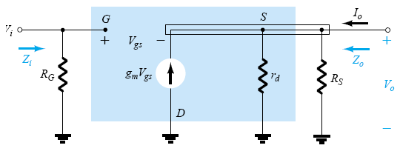
JFET SOURCE-FOLLOWER(CD)

Slide 23


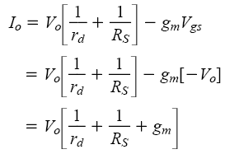

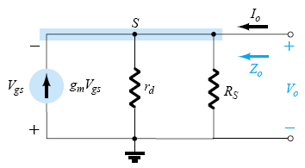



JFET SOURCE-FOLLOWER(CD)

Slide 24


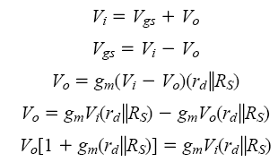

JFET SOURCE-FOLLOWER(CD)

Slide 25
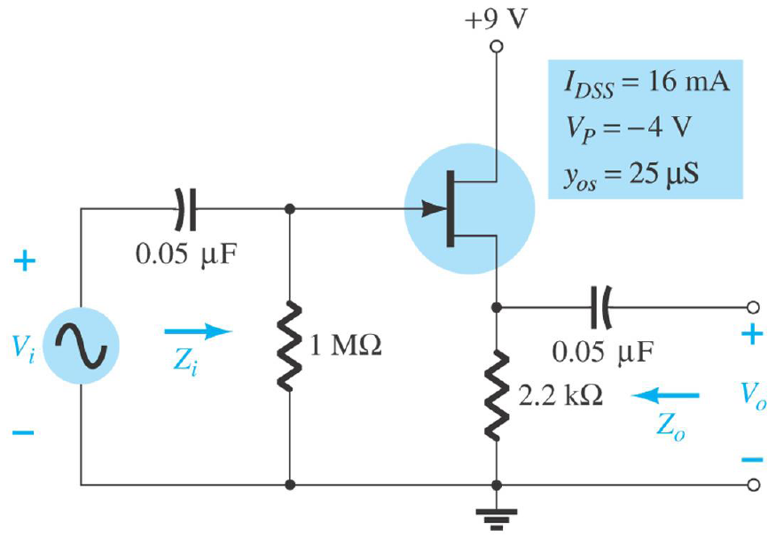
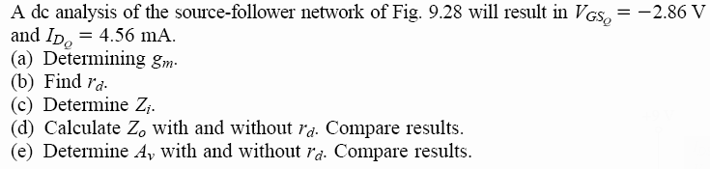
CONTOH

Slide 26
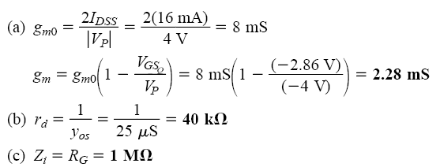
CONTOH

Slide 27
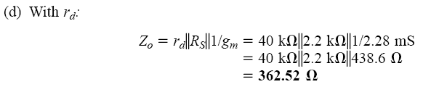
CONTOH

Slide 28
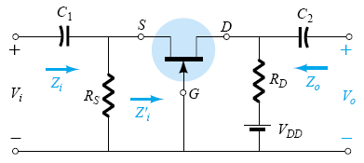
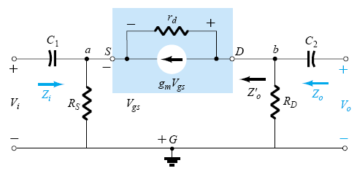


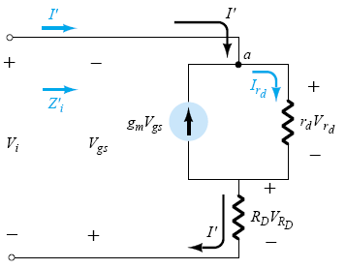

JFET COMMON-GATE CONFIGURATION

Slide 29








JFET COMMON-GATE CONFIGURATION

Slide 30






JFET COMMON-GATE CONFIGURATION

Slide 31


CONTOH

Slide 32


CONTOH

Slide 33


CONTOH

Slide 34

DEPLETION-TYPE MOSFETs

Slide 35


CONTOH

Slide 36



CONTOH

Slide 37





ENHANCEMENT-TYPE MOSFETs

Slide 38




E-MOSFET DRAIN-FEEDBACK

Slide 39








E-MOSFET DRAIN-FEEDBACK

Slide 40





E-MOSFET DRAIN-FEEDBACK

Slide 41


CONTOH

Slide 42

CONTOH

Slide 43



CONTOH

Slide 44

CONTOH

Slide 45
SOAL

